Slide 1

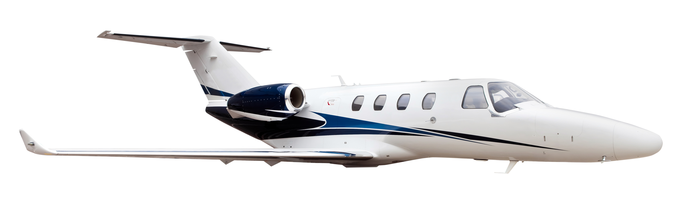

Slide 2
We’ve helped a major aerospace company develop the next big idea in their industry.

